Slide 1
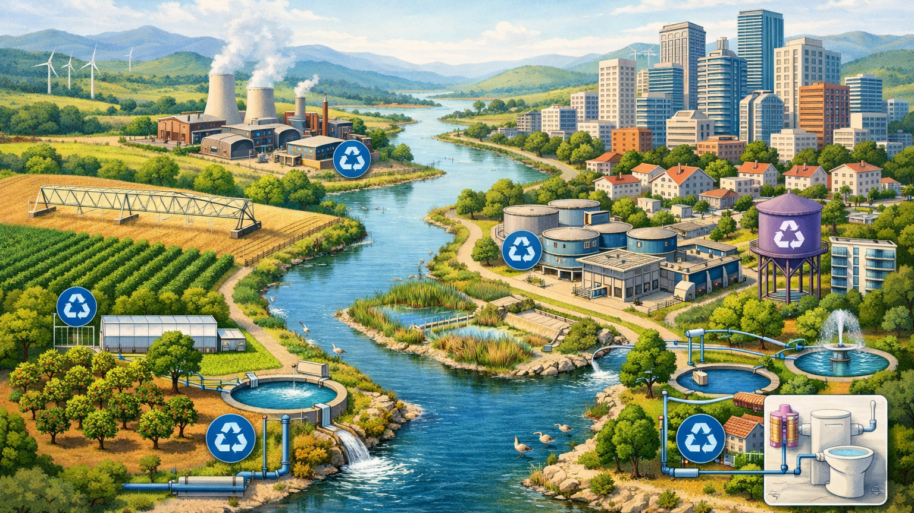


Session 5 – Non-Conventional Resources
Mainstreaming of Non-Conventional Resources in Water Mix
Circular water economy for basin resilience: diversifying the “water mix” with non-conventional resources

Slide 2
INDEX: Non-Conventional Resources (NCR)
Quick Outlook
NCR – Pros & Cons
Desalination
Water reuse
1
2
3
4
Notes:
B: Then we’ll move on with a couple of case studies and see who collaboration with different social agents/stakeholders is vital in this process

Slide 3
INDEX: Non-Conventional Resources (NCR)
Quick Outlook
NCR – Pros & Cons
Desalination
Water reuse
1
2
3
4
Notes:
B: Then we’ll move on with a couple of case studies and see who collaboration with different social agents/stakeholders is vital in this process

Slide 4

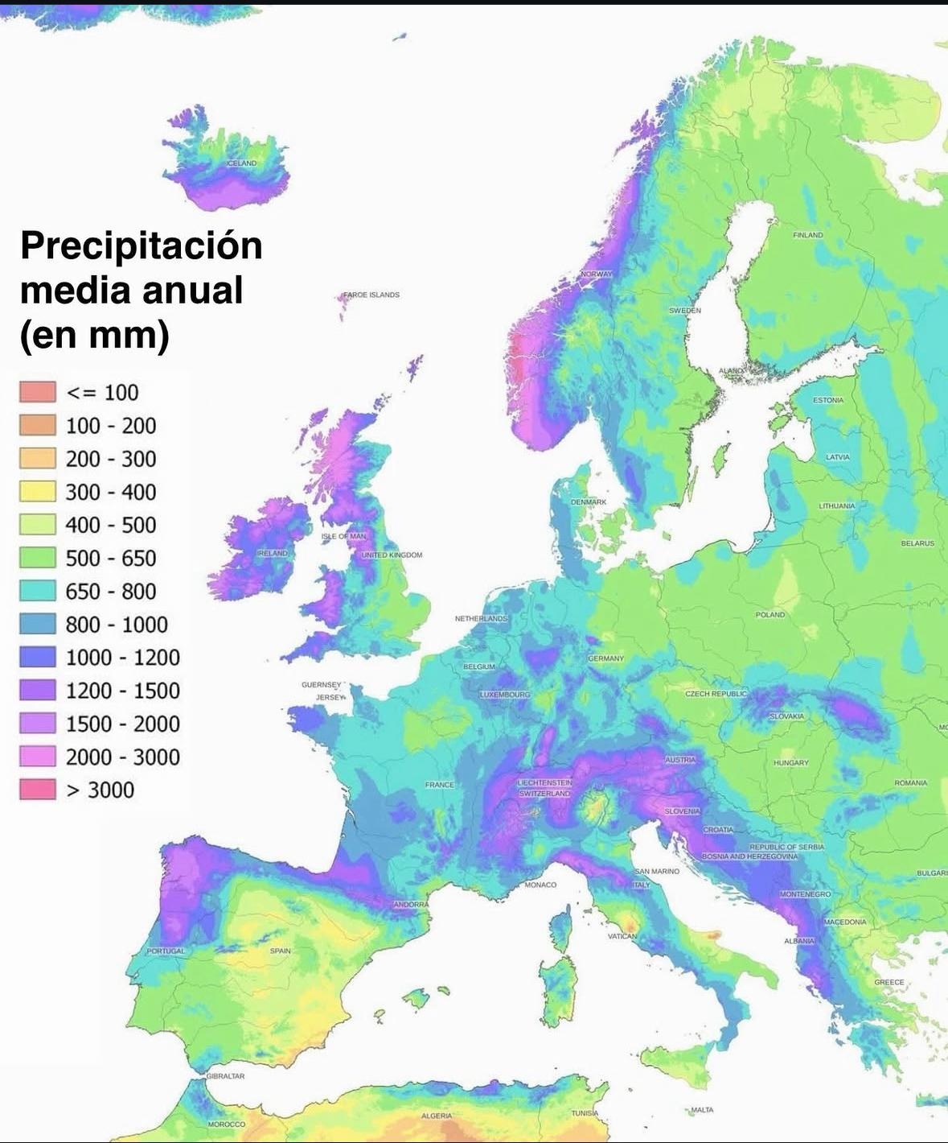
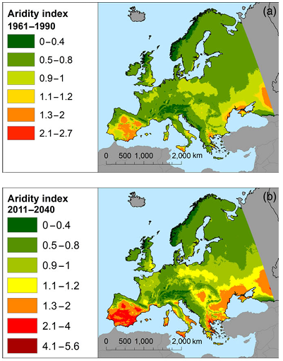
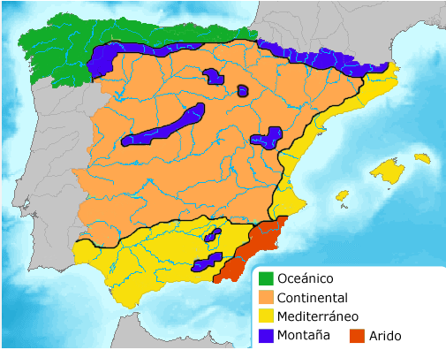
Water scarcity in Spain
  In some Spanish regions the WEI+ is already very high, and climate change will worsen the situation.
Annual rainfall average
(mm)
Oceanic
Continental
Mediterranean
Mountain
Arid

Slide 5
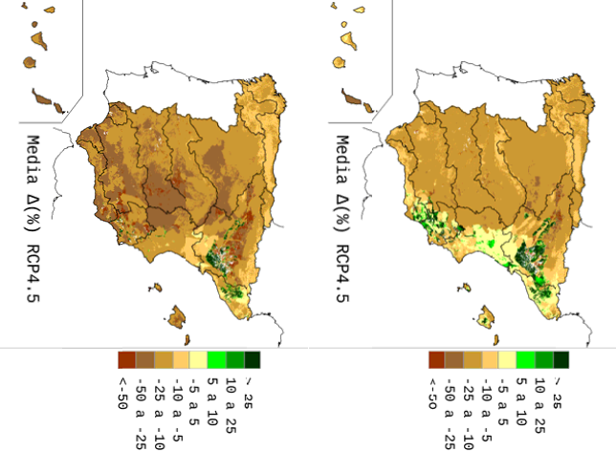
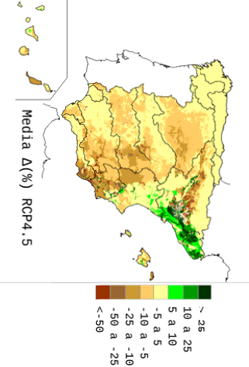





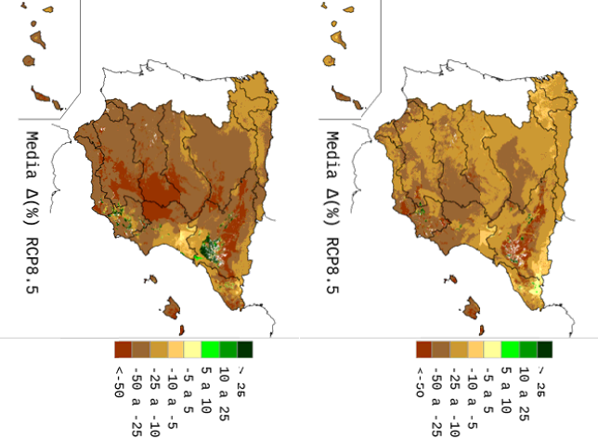
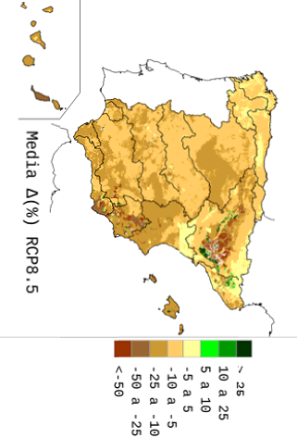


Impact of Climate Change on water resources
2070 - 2100
2040 - 2070
2010 - 2040
Average Run-off decrease
Decrease of rainfall
Increase of potential ET
15-40 % Decrease in Runoff
Increase in the frequency of droughts
Source: CEDEX (2017). Assessment of the Impact of Climate Change on Water Resources and Droughts in Spain.

Slide 6
NCR: Quick Outlook
Region | Total NCW (hm3/yr) | % of total | Desalination | Water Reuse
Global | ≈ 100,000 | 1 % | 95,000 | 5,000
South America | ≈ 400 | < 0,1% | 250 | 150
Brazil | ≈ 60 | < 0,1% | 0 | 60
EU | ≈ 2,500 | 0,4 % | 1,500 | 1,000
Spain | ≈ 1,000 | 3 % | 500 | 500
NCR are still marginal globally but strategically essential in water stressed regions
Desalination dominates worldwide NCR with 95% production
Water reuse is growing fast but remains underused
Spain is the European leader in NCR
NCR is key for climate adaptation
Scaling up requires energy efficiency, investment and public aceptance, especially for reuse
Only 10% of total wastewater

Slide 7
INDEX: Non-Conventional Resources (NCR)
Quick Outlook
NCR – Pros & Cons
Desalination
Water reuse
1
1
2
2
3
4

Slide 8
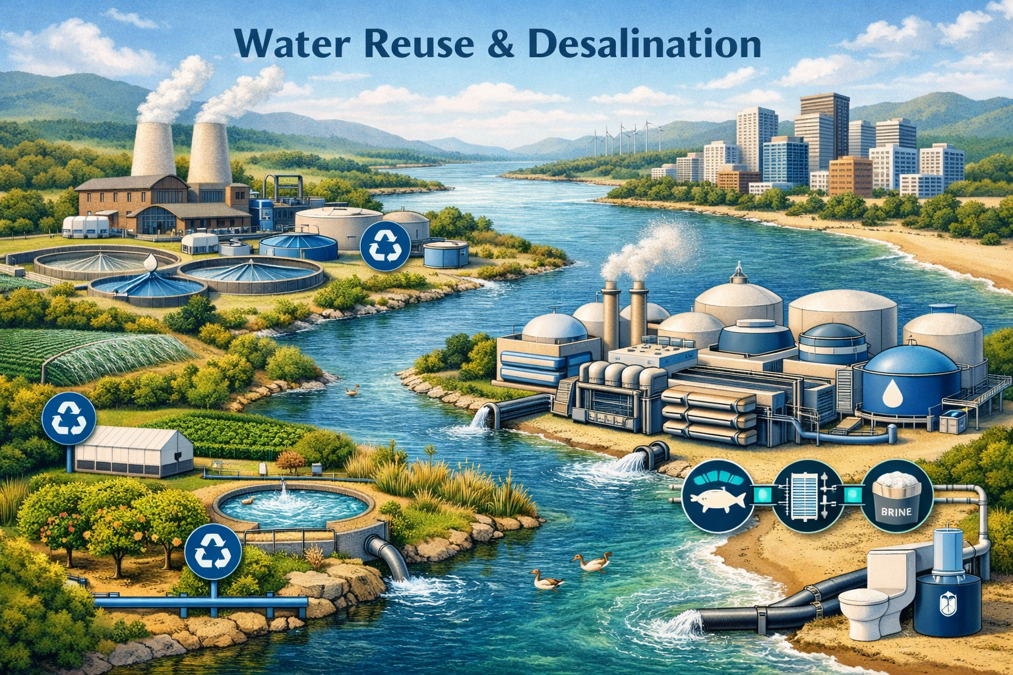


NCR: Desalination and Reused Water
Advantages
Disadvantages
Constant availability
Reduce pressure on natural resources
Essential in arid regions: coastal & drought-prone areas
Promote circular use
Technological improvements
High energy demand
High operational costs
Geographical limitations
Technical complexity
Regulatory and social barriers

Slide 9
INDEX: Non-Conventional Resources (NCR)
Quick Outlook
NCR – Pros & Cons
Desalination
Water reuse
1
1
2
2
3
4

Slide 10




Desalination: strengths and weaknesses
Technological improvement
Resilience against Scarcity, droughts, and climate change.
Potential uses: urban, agriculture, industry, environment, “Plan B”
Production costs:
Today: 0,5 – 1,00 €/m3
Much greater than regulated surface water : 0,1-0,2 €/m3
Similar as pumped groundwater
0,0010 €/lit. ( ≈ 1000 times cheaper than bottled water)

Slide 11



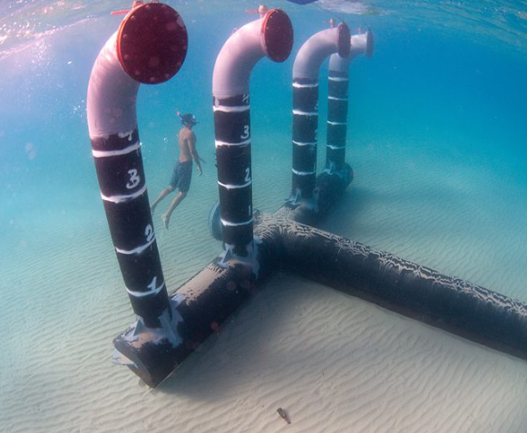

Desalination: strengths and weaknesses
High energy consumption:
Environmental impact and toxicity of discharges:
Today: 2,5 to 3 kWh to produce 1 m3 of desalinated water (household equivalent to fridge consumption)
90% reduction in 50 years 🡪 energy recovery in membranes, close evaporation systems and use of renewable energies
From every 100 L of seawater (35 gr/lt), 45 liters of desalinated water and 55 liters of brine (65-70 gr/lt) are obtained.
Just a few meters from the brine discharge point, the concentrate is indistinguishable from seawater in terms of salinity and water quality

Slide 12
Desalination: takeaways
Integrated planning and management, capable of ensuring a fair distribution of costs and benefits
Complementary alternative in water mix
Achieved very competitive production costs
Minimal environmental impact
Very appropriate in combination with the use of renewable energies
In water stress regions, desalination is a highly advisable alternative – often the only one – to achieve water security

Slide 13
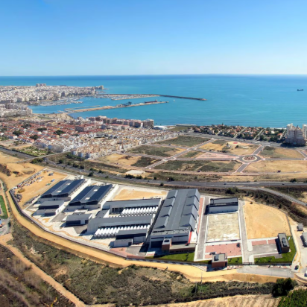
Desalination plant in Javea, Spain
Coastal city with highest precipitation in water basin
Area with lack of natural groundwater
Low resilience to water scarcity during dry summer
Supplies water for urban use during touristic season

Slide 14
INDEX: Non-Conventional Resources (NCR)
Quick Outlook
NCR – Pros & Cons
Desalination
Water reuse
1
1
2
2
3
4

Slide 15
NCR: Water reuse
Challenges: social reluctance and administrative hurdles.
  New laws to increase social trust (risk management, responsibility)
Advantages: reliability during droughts, resilience against climate change, competitiveness in agricultural sector
Environmental protections reducing WWTP and factory pollutant discharge, reduce impact on natural reserves

Slide 16




NCR: Water reuse
Accelerated tendency: +50% volume reuse water in las 15 years)

Slide 17
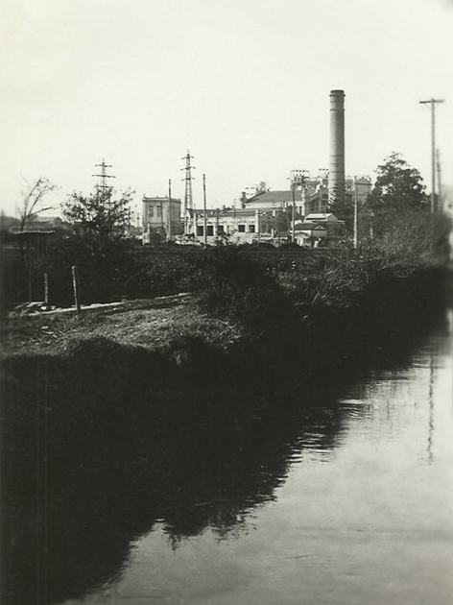
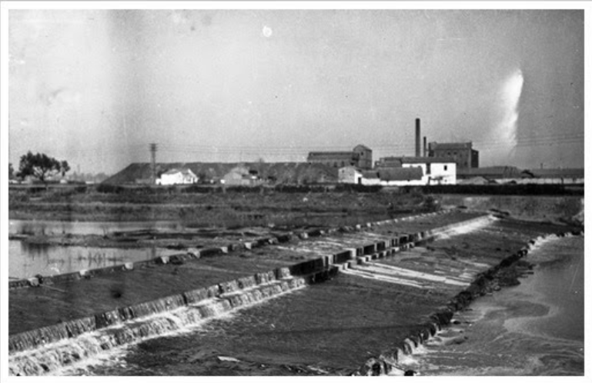
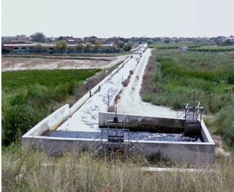
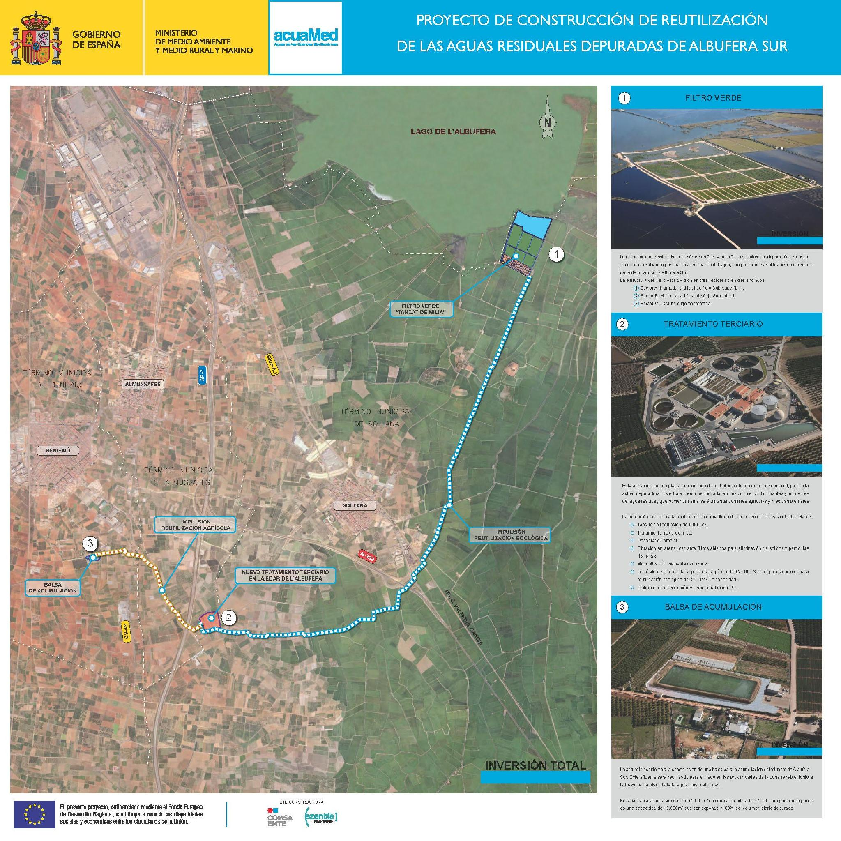


Water Reuse: Golden Irrigation Canal, Spain
Tertiary Treatment
Waterflow: 34.000 m³/day
Investment: 14M€
Water Reuse from Pinedo WWTP (biggest in the region)
Reuse of 22 hm3/yr (68% total output)
Turn sewage pollutants into fertilizers
Use for rice paddles with economic and ecological importance
Strategic advantage: stopped relying harvest with rainfall

Slide 18
Session 5 – Non-Conventional Resources
Thank you for your attention
Circular water economy for basin resilience: diversifying the “water mix” with non-conventional resources

