Slide 1
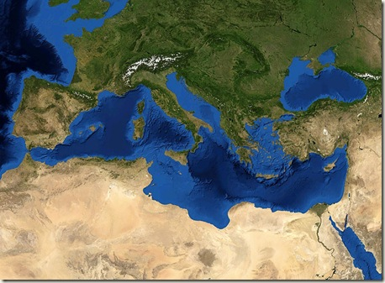


MENBO Mediterranean Network of Basin Organisations
REMOB Réseau Méditerranéen des Organismes de Bassin
REMOC Red Mediterránea de Organismos de Cuenca
Euro-INBO 2018
Laura Tanco Ballesteros
Planning Office, Jucar River Basin Authority

Slide 2

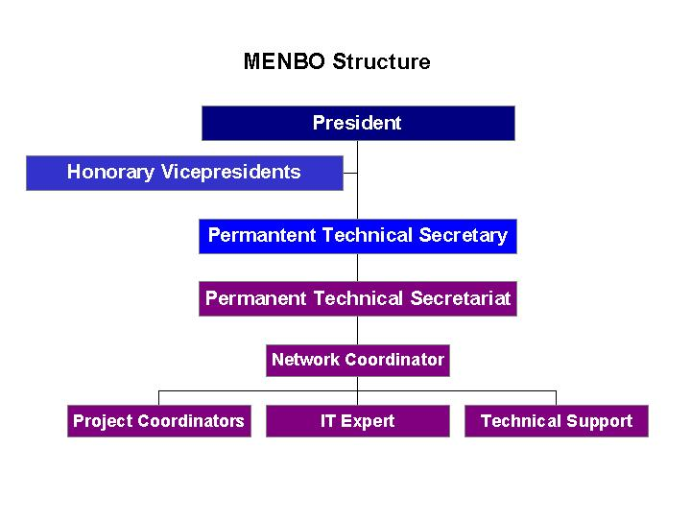
REMOC- REMOB – MENBO overview
It was created in 2003, in Valencia.
MEMBO is a regional network integrated in the International Network of Basin Organisations (INBO)
Menbo has over 40 members coming from more than 16 different countries
Main working languages: Spanish, French, English
MEMBO’S STRUCTURE
President: Daniel Azzopardi, Malta
Technical Permanent Secretary: D. Teodoro Estrela, CHJ
General coordinator: Ramiro Martínez
General Assembly + Executive Committee

Slide 3
Main Objectives of MENBO
Promote the integrated water resources management at basin level as an essential tool of sustainable development
Develop lasting relationships among water managers in the Mediterranean region
Foster the exchange of information and knowledge and capacity building between its members

Slide 4
SELECTED ACTIVITIES
I. Water Strategy in the Western Mediterranean 5+5 (WSWM)
II. Peer Review Project

Slide 5











I. Water Strategy in the Western Mediterranean 5+5 (WSWM)
A Spanish-Algerian initiative, started in February 2014; Strategy adopted in Algiers, on 31st March 2015. Action Plan endorsed in Marrakech on 16th December 2016.
By Ministers of the 5+5 Dialogue: Algeria, France, Italy, Libya, Malta, Mauritania, Morocco, Portugal, Spain, and Tunisia.
With the presence and collaboration of:
    European Commission
    Union of the Arab Maghreb
    Union for the Mediterranean
    MENBO (Technical Secretariat)

Slide 6
I. Water Strategy in the Western Mediterranean 5+5 (WSWM)
WSWM is a guiding document with orientations and objectives, agreed by Western Mediterranean countries (5+5).
Objectives: regional sustainable growth, preserving water quality, social prosperity, access to water for all, cooperation, exchange of knowledge,...
Structure: 13 priorities issues (/ 3 blocks)
WSWM implementation→ Annexed Action Plan, compiling over 60 proposals from 5+5 members and partners.

Slide 7
… WSWM 5+5 - Structure
1. Enhancing Western Mediterranean country policies’ convergence towards the general principles of a sustainable water policy | P1: Developing and starting up clearly defined legal frameworks
 | P2: Establishing governance adapted to integrated water management
 | P3: Implementing cost-recovery
2. Foster cooperation in relation to regional matters | P4: Capacity building
 | P5: Innovation development in the water sector
 | P6: Water-energy-food nexus
 | P7: De-pollution of the Mediterranean
 | P8: Mobilising water-related innovative financing solutions for the application of the Strategy
3. Promoting water management improvement | P9: Climate change adaptation
 | P10: Increasing and mobilising the available resources
 | P11: Water use efficiency improvement
 | P12: Flood prevention
 | P13: Protection of water quality and biodiversity

Slide 8
…WSWM 5+5 – ACTION PLAN
Projects with a regional dimension and national projects that are replicable at regional level, have been prioritised;
The projects have been divided into two distinct blocks: on the one hand those related to training, capacity building and governance and on the other hand projects related to infrastructures.
To avoid duplication: ongoing processes have been analysed with the aim to optimise resources; cooperation with other initiatives and strategies to set up synergies, has been considered.
Service Actions (training, capacity building and governance)
Projects with the objective of developing analyses, studies, research, training, knowledge transfer and cooperation.
A total of 54 projects are included within the 10 actions
Approximate budget: 144 Million €
Infrastructure Actions
Projects on construction, viability analyses, etc.
A total of 6 projects are included within the 4 actions
Approximate budget: 279 Million €

Slide 9
…WSWM 5+5 – The way forward
Alignment with other regional initiatives, especially with this one UfM.
Implementation of the Action Plan, through the proposed projects.
Ensure the continuity of the process via the rotating Presidency and Technical Secretariat of MENBO .
Compliance with the Rules of Procedure elaborated for the process.
Ensure funding via the implication of donors.

Slide 10
II. Peer Review
Why? Purpose: Improve the implementation of the Water Framework Directive (WFD) and the Floods Directive (in phase II)
How?: A voluntary system to exchange knowledge on how to implement the Directives, allowing mutual learning between participants (Peers)
Who participates?: Practitioners from River Basin Authorities involved in the implementation of the WFD (and Floods Directive)

Slide 11
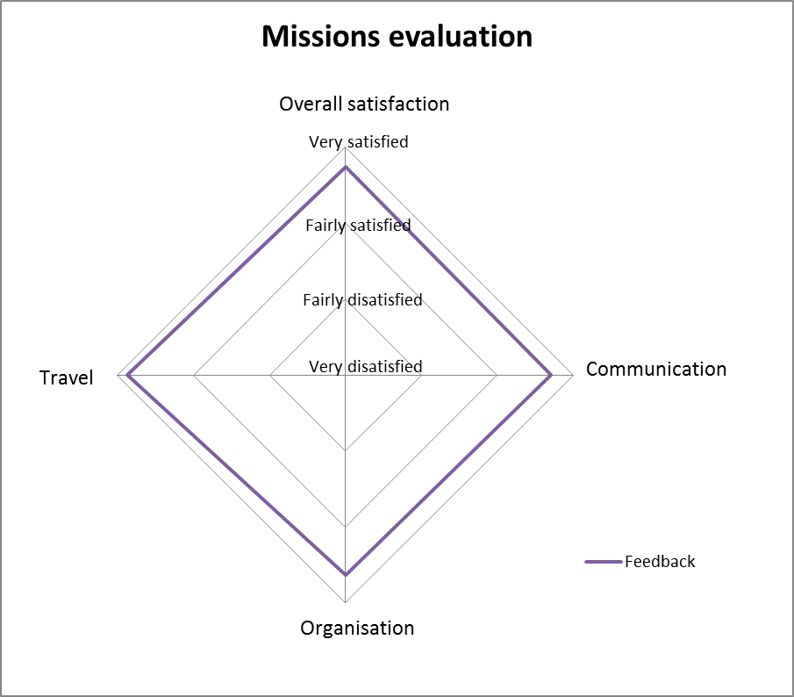
II. Peer-Review Mechanism
First Phase - a Success Story
phase I: end 2014 - 2015 - 2016
  Secretariat:
Coordinator: Office International de l’Eau (OIEAU)
Partners: NIHWM (Romania); MEMBO
PROCEDURE
Main tool: “Missions” in the Competent Authorities (CA) where experts worked to provide an expert opinion about implementation issues of the RBMP (River Basin Management Plans)
3 targeted workshops + final evaluation Workshop:
- Groundwater (Kalmar, Sweden - 09/2016)
- Data Management (Sophia Antipolis, France - 10/2016)
- Program of Measures (Lourdes, France - 10/2016)
- A Final Evaluation Workshop (Brussels, 10/2016)

Slide 12
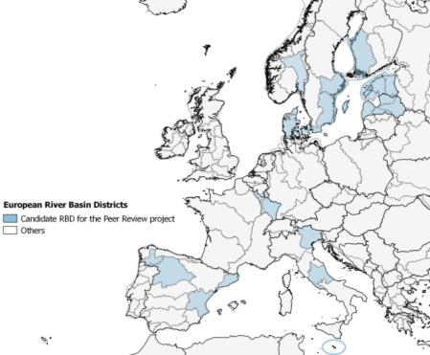
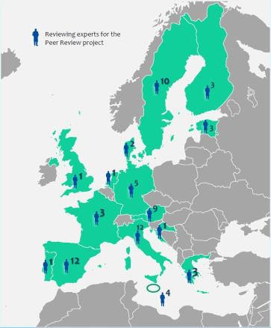
II. Peer-Review Mechanism
…First Phase – Outcomes
17 applications from River Basin authorities →15 Missions conducted
70 experts from 15 different member states
Reports of each mission available on the Website
Final Lessons Learnt Report sent to the Strategic Coordination Group (SCG) of the Common Implementation Strategy (CIS)
http://www.aquacoope.org/peer.review/

Slide 13
II. Peer-Review Support Process
…Second Phase
September 2017 – December 2019
Implementation of the WFD and the Floods Directive (new)
Under a New name: “Support Process”
Tools: Missions, Webinars (on line meetings)
Secretariat: Office International de l’Eau (OIEAU), Ecologic Institute (Alemania), Water Institute of Hydrology and Water Management (Rumania), Mediterrnean Network of Basin Organisations (MENBO)

Slide 14
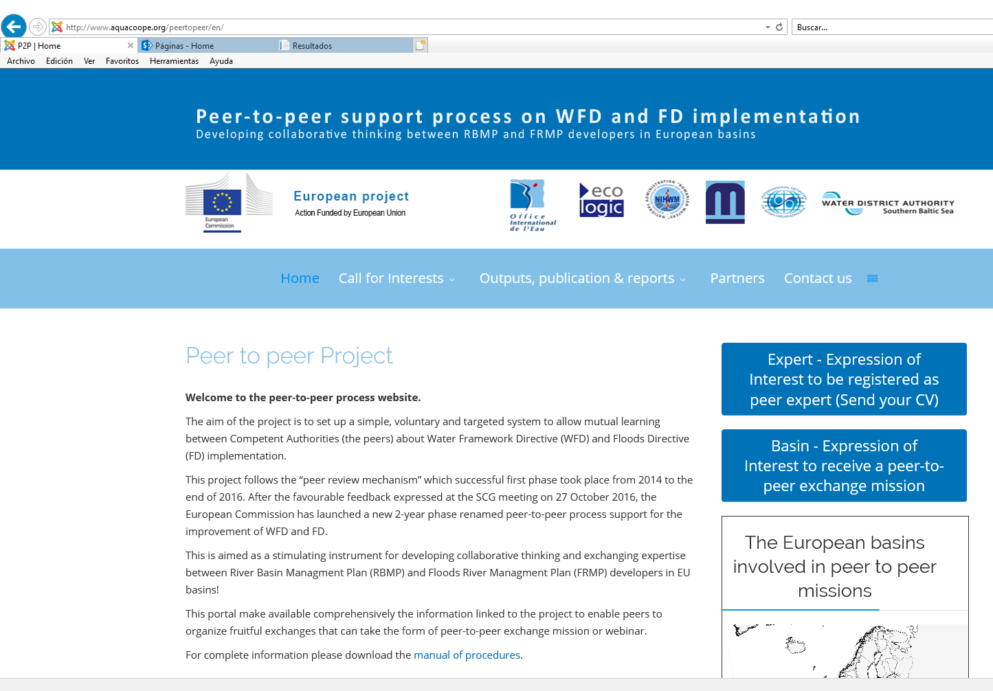
II. Peer-Review Support Process
…Second Phase – State of Play
So far: 10 expressions of interest from RBA and 33 demands from experts
The call for expression of interest is still open → no missions have taken place so far.
Ongoing Matchmaking
exercise (by OIEAU)
of RBA and experts
http://www.aquacoope.org/peertopeer/en/

Slide 15
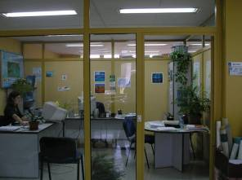
CONTACT
TECNICAL PERMANENT SECRETARIAT
Avda. Blasco Ibáñez, 48-5ª
46010 Valencia
Tel. +34 96 3938942
Fax + 34 96 1125750
Email: remoc@chj.es
www.remoc.org
Notes:
Contact details

